Slide 1
Pension
Management
System
Done By: Ala Baby Triveni
Emp id: 2182959

Slide 2
Table of Contents
Introduction
Features
Implemented Methods
Spring-boot Architecture
Procedure
@Annotations
Requirements
Advantages
Conclusion

Slide 3
Introduction
The purpose of this program is to develop a system that would
keep records of employees or pensioners data including their
pension plan, allowances, gratuity, taxes, net pay, rent pay and
also calculate the pay of the pensioners taking into consideration
the employees/pensioner’s data.

Slide 4
Features
1. Add/Edit/Delete Employee/Pensioner Records
2. View Employee Records
3. Search Records
4. Generate Payslips
5. Calculate Pension

Slide 5
Implemented Methods
GetAllPensions
SaveOrUpdate
Approve/id
CheckStatus/id
IssuePension
LoadPension

Slide 6
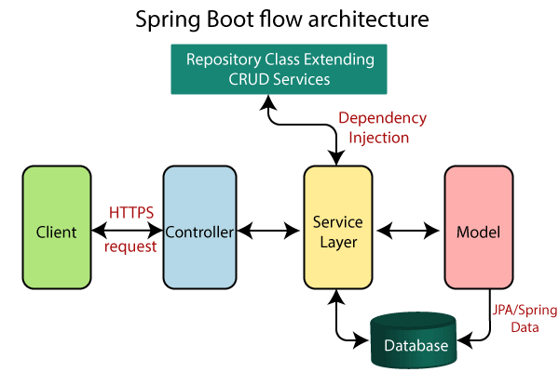

Slide 7
Procedure
Create and setup Spring Boot Project.
Creating Or importing the spring boot project a file name Application.java
Run the Spring Boot Application.
We have to build the application by using maven clean install.
Tomcat server will be started.
Now we have to do dockerizing image.

Slide 8
Continue…
Docker-compose -f docker-compose-mysql.yml up -d.
Check the data in Postman by using url https://localhost: port number/method name.
Now we can perform the actions of methods on the data.

Slide 9
Some of @Annotations used…
@SpringBootApplication: spring Boot @SpringBootApplication annotation is used to mark a configuration class that declares one or more @Bean methods and also triggers auto-configuration and component scanning.
@RestController: RestController annotation is a convenience annotation that is itself annotated with @Controller and @ResponseBody . This annotation is applied to a class to mark it as a request handler.
@Autowired: @Autowired annotation is optional for constructor based injection. Here, the person object from the container is passed to the constructor while creating the Customer object.

Slide 10

Requirements
Software
Spring-Boot Framework
Necessary dependencies & database
Postman & Docker
Java SDK 11 or above
Hardware
Windows 10 or above
RAM 8GB

Slide 11

Advantages
We can implement in any company for the employee pension data.
It replace file records and have a back-up option in this project.
Easy to perform operations like add, update, search, delete etc.

Slide 12
Conclusion
This Pension Management System is designed to manage pension activities for both applicants and pension admins. It is beneficial to a pension management company because it minimizes the time required for manual pension management processing. Thus, the basic aim of carrying out this project is to develop a solution that will largely, help in the aspect of pension management which would help eliminate the problems associated with the manual process.

Slide 13


